Slide 1
Cognitive subjectivity
Seokwon

Slide 2
Context
1. Rashomon (1950)
2. Three trusts
3. 12 Angry Men (1957)
4. Existing Rashomon effect Game - Red Riding Hood

Slide 3
VR
Real-time collaboration
Spatial memory
cut down the money
Time efficiency
Unlimited repetitions
Reduced risk of hungry projects
Impossible scenarios are possible
Various perspectives

Slide 4
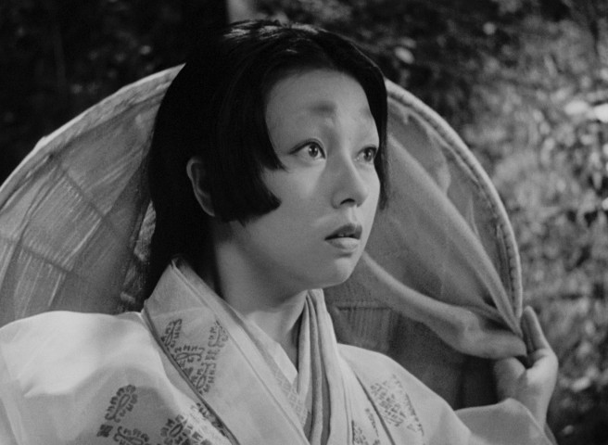
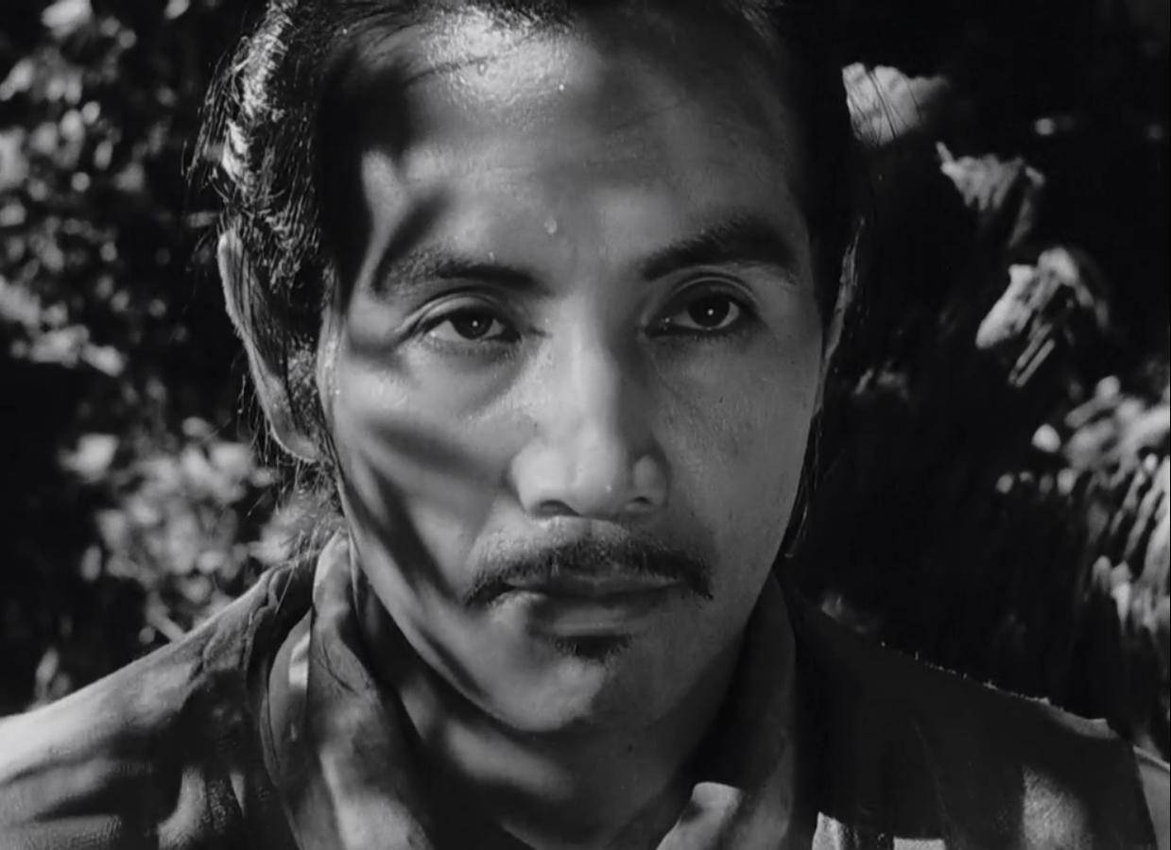
Rashomon (1950)
Bandit
Samurai’s Wife
Samurai
I killed Samurai !!
I killed my husband (samurai) !!
I killed myself !!
To be famous as Bandit
To keep her fidelity as wife
To be honoured as Samurai

Slide 5
Objective Data | Interpretive Concepts | Basic Principles
Result | Instinct | 2 + 13 = 15
Record | Mind | law of supply and demand
Photo | Mature | Natural law
Data | Goal

Slide 6
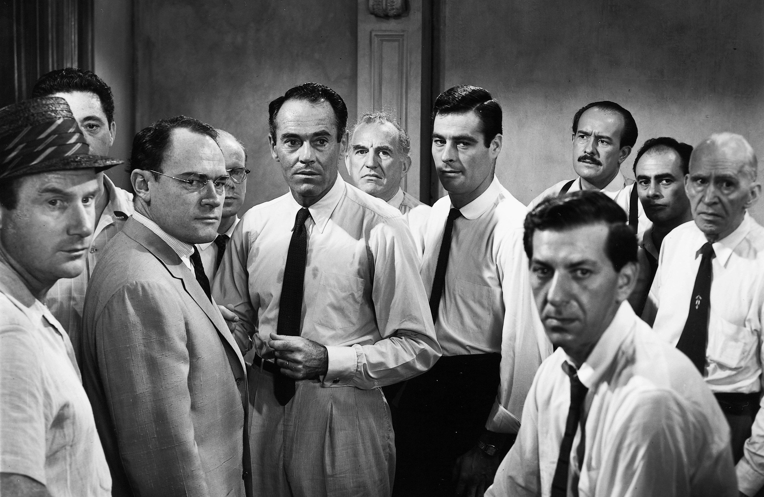
12 Angry Men (1957)
What hide the truth in the movie?
1. Attribution
2. Aggression
3. Attraction
4. Environment

Slide 7
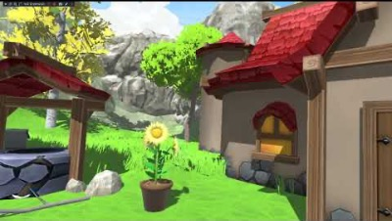

Slide 8
Bibliography
1. Hanseon P, [Why is my heart like this?] 'Rashomon effect', the attribute of humans dealing with the truth, 2019.02.24 10:00, Dong-A Science [accepted 18, Mar 2021].
2. Suji. J, VR Rashomon, 2019.08.19, YouTube
3. YouTube Music, Rashomon, 2015.05.06, YouTube

Slide 9
Thanks

